Slide 1
Long COVID Web
Angela M. Cheung, MD, PhD, FRCPC
Senior Physician Scientist | Professor of Medicine
University Health Network | University of Toronto
LCW Webinar
October 10, 2023 | Toronto

Slide 2

Long COVID Web
A network of networks supporting and conducting research into Post-COVID Condition (PCC)
Vision: Canada without PCC
Mission:
  1) Accelerate the discovery and validation of Canadian-led science in PCC.
  2) Activate a learning health system that prioritizes the needs of individuals with PCC.
  3) Identify the best therapeutics and practices, and accelerate equitable access to PCC care.
  4) Maintain rigorous surveillance of the impact of PCC.
Notes:
Vision: We will support and conduct research into the complex biological, social, cultural, and environmental interactions that determine the health of individuals suffering from PCC and their families, and improve the health of individuals, communities, and global populations.
"Web“: refers to the patient, clinician, and researcher interconnections across all pillars of science, as well as the adaptability, flexibility, and speed with which solid connections and meaningful knowledge exchange can be formed.

Slide 3
Key Driving Questions

Slide 4
Network Organization and Governance
Clinical
Health
Services
International Advisory Board
EDI Com
INDIG
COM
Steering Committee
Partner Networks
Patient
Council
Knowledge Mobilization Team
Biomedical
Population
Health
Exec Com
Operations Committee

Slide 5
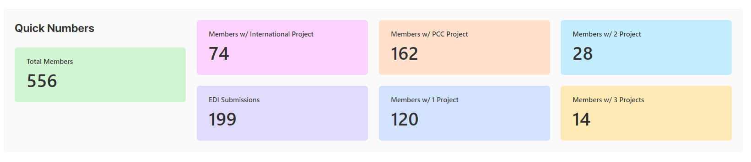
LCW Registration Survey
2023.10.10

Slide 6
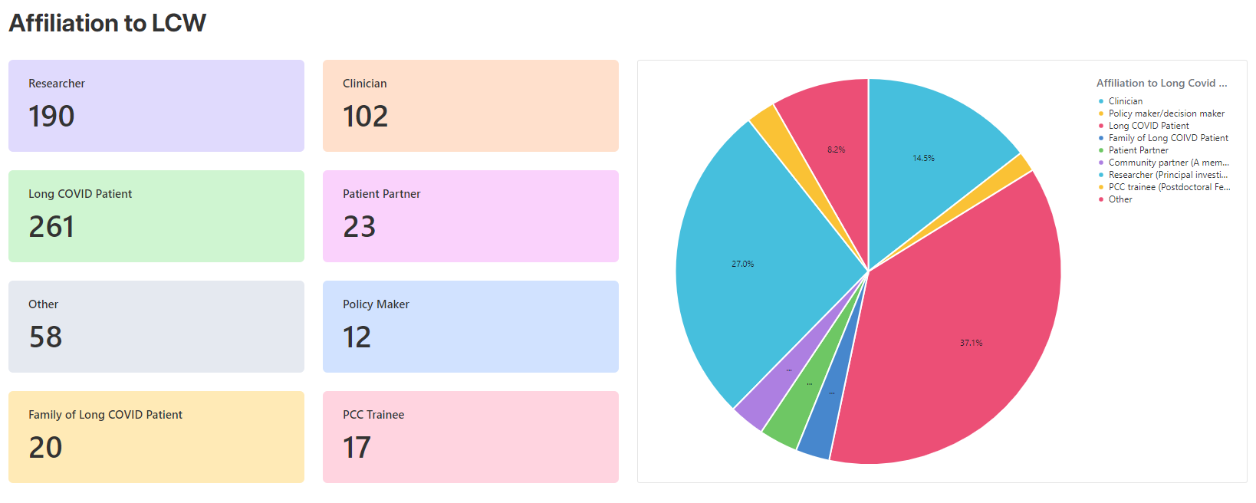
LCW Registration Survey
2023.10.10

Slide 7
What we have accomplished so far …

Slide 8
Established teams, working groups and committees
Clinical
Health
Services
International Advisory Board
EDI Com
INDIG
COM
Steering Committee
Partner Networks
Patient
Council
Knowledge Mobilization Team
Biomedical
Population
Health
Exec Com
Operations Committee

Slide 9
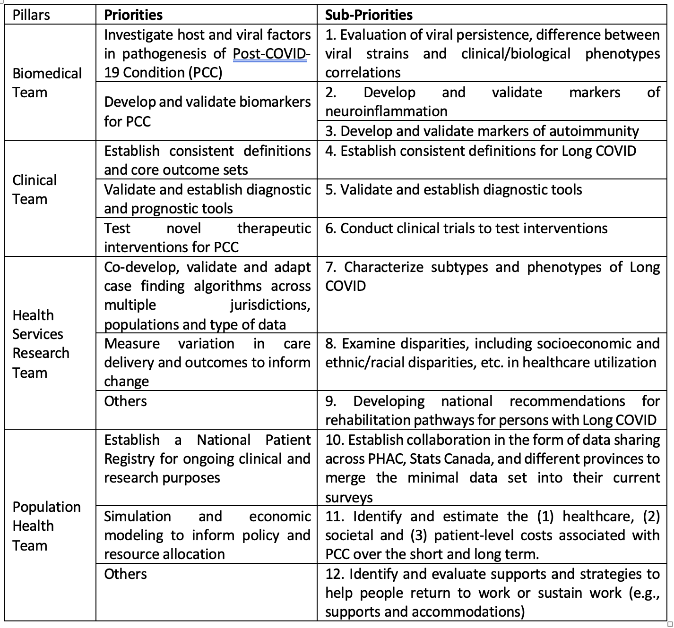
Our 1-2year priorities

Slide 10
Call for proposals
1st round – foundational grants ($100K x 4, one for each pillar)
2nd round – we just closed the application, and have received:
  19 proposals for $100K (n=4-8)
  12 proposals for $50K (n=6-10)
  2 proposal for $25K (n=4-6)

Slide 11

Knowledge Mobilization and Communications
1) Regular town hall meetings – to inform members of network activities
2) Annual LCW network meetings
  – 1st one in Montreal in Sept 2023;
  partnered with FRQS
  -- Trainee awards
  -- 2nd in Alberta October 2024
3) LCW monthly webinars – to update on science
4) LCW ECHO – to educate health care providers and create a community of practice

Slide 12
Each team, working group and committee have their own meetings
Clinical
Health
Services
International Advisory Board
EDI Com
INDIG
COM
Steering Committee
Partner Networks
Patient
Council
Knowledge Mobilization Team
Biomedical
Population
Health
Exec Com
Operations Committee

Slide 13
Next step, for us to collate new science
over this past year …

